Slide 1
Medical Information Retrieval

Slide 2
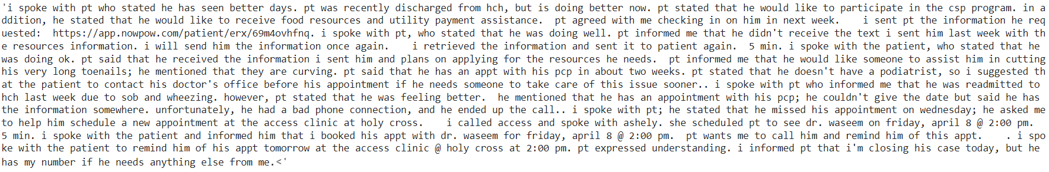
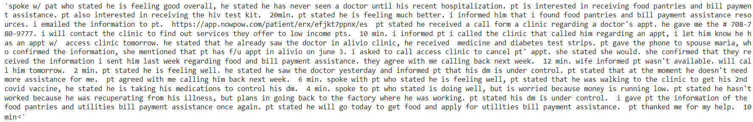
Sample Notes
Readmitted very long sample Notes
Not readmitted very long sample Notes

Slide 3
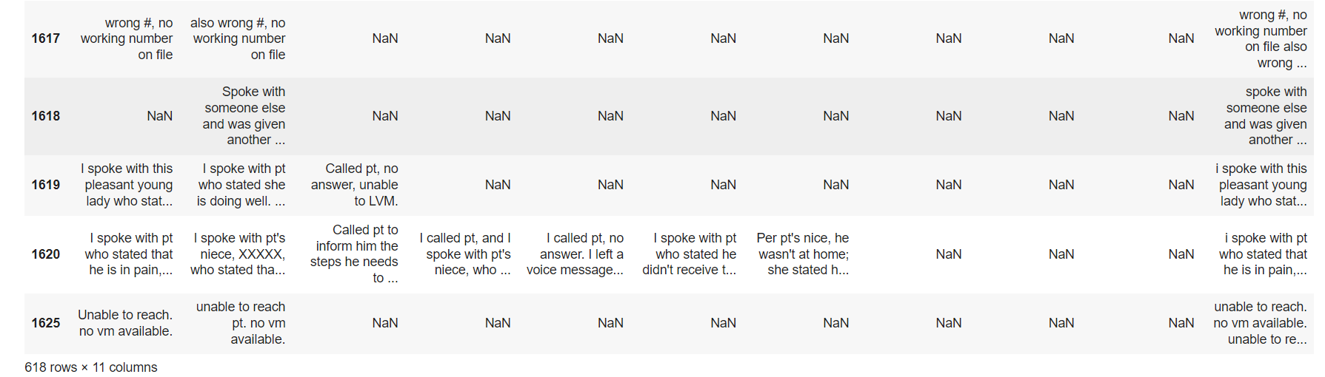
EDA

Slide 4
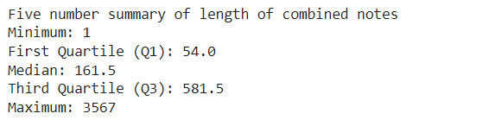
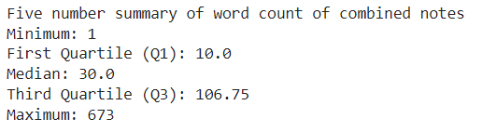
EDA
Five number summary on notes length.
Five number summary on word count.

Slide 5
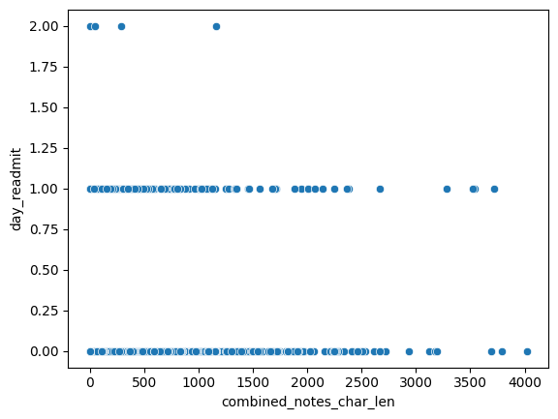
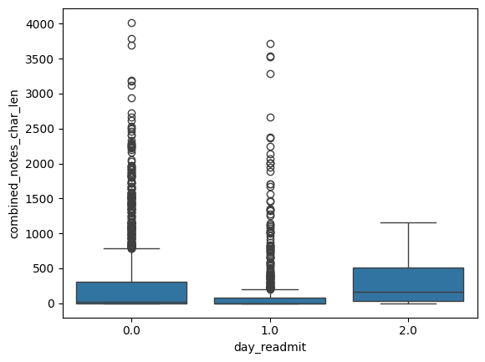
Visualizations
Data Distribution of combined notes vs day_readmit (Readmission)

Slide 6
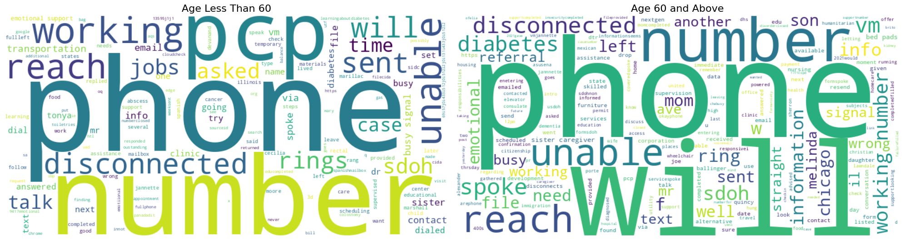
Age vs Notes

Slide 7
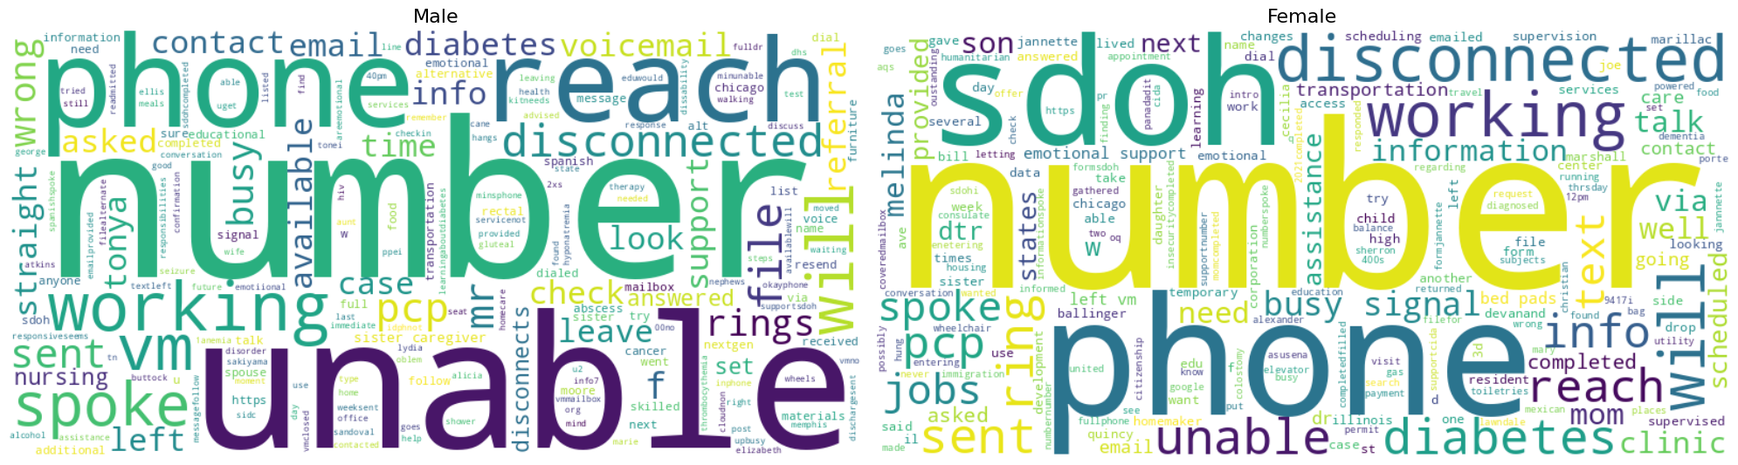
Gender vs Notes

Slide 8
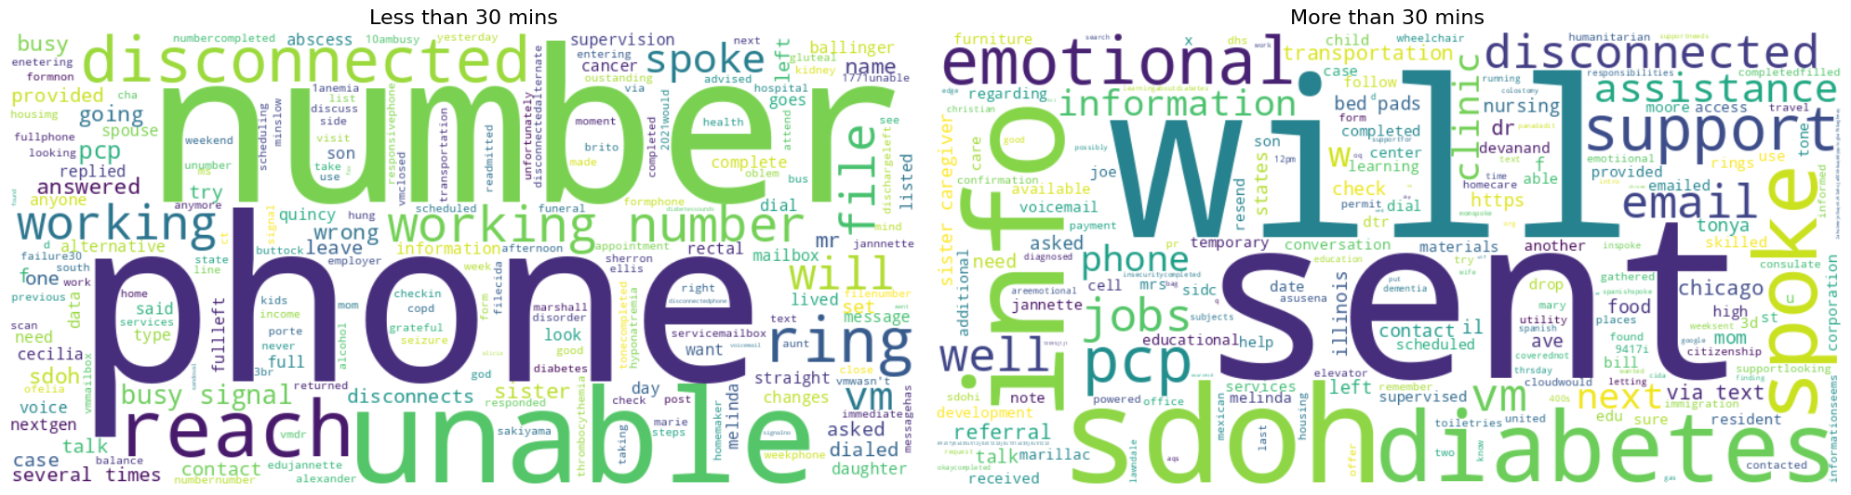
Total conversation time vs Notes

Slide 9
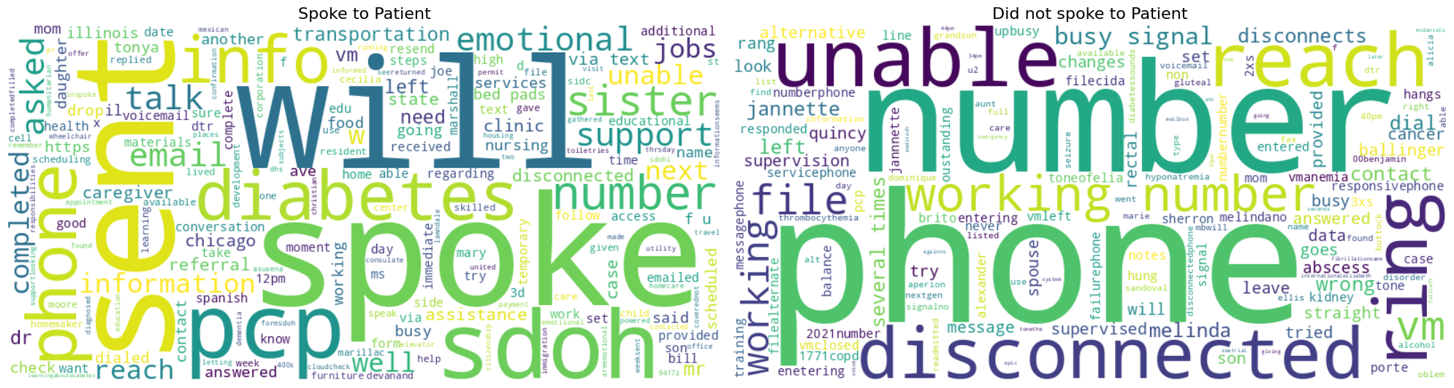
Spoke to Patient vs Notes

Slide 10
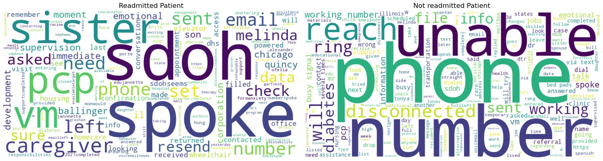
Readmission vs Notes

Slide 11
Contextual Embedding Models (BERT variants)
Generate topic descriptions for the list of the targeted topics using Generative LLMs
Divide patient combined notes into individual sentences
Vectorize each sentence of the combined notes and generated topic descriptions using an Embedding model
Calculate Cosine Similarity between each sentence vs each generated topic description
Assign the most similar sentence to the respective topic

Slide 12
BioBERT (Topics)
Topic Descriptions
SDOH
"The social determinants of health (SDOH) are the non-medical factors that influence health outcomes. They are the conditions in which people are born, grow, work, live, and age, and the wider set of forces and systems shaping the conditions of daily life.",
Food insecurity
"Access to affordable, healthy food options is an important social determinant of health that can impact a person's overall wellbeing."
PCP
"Primary care physicians play a crucial role in addressing social determinants of health in clinical settings, though they may sometimes lack confidence in addressing patients' social needs.",
Bill Payment Assistance
"Many hospitals offer financial assistance programs, sometimes called 'charity care,' which provide free or discounted health care to people who need help paying their medical bills.",
Social Worker
"In primary healthcare settings, social workers deliver or support the delivery of mental healthcare, but their role extends beyond that domain to encompass a broader set of services that contribute to the individual's health and wellbeing.",
Community health worker
"Community health workers form the backbone of Partners In Health, providing home visits, helping patients access medication and essential resources, and advocating for patients in the healthcare system.",
Referral
"Social workers in healthcare help to address financial stress by referring patients to community resources, financial assistance plans and legal aid as needed."

Slide 13
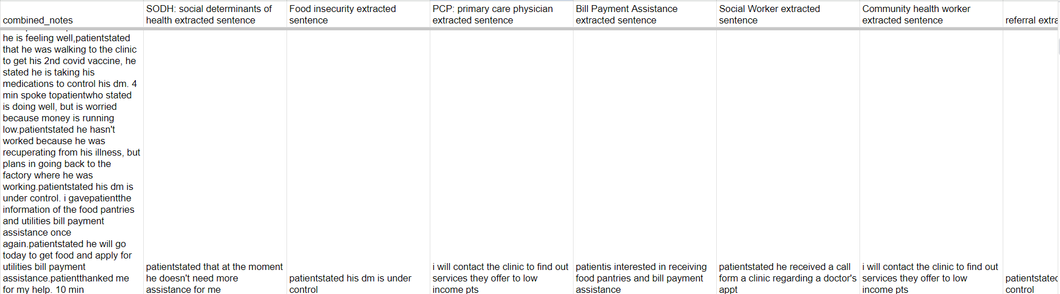
BioBERT (Topics)
Sample screenshot of a record extracted

Slide 14
Contextual Embedding Models – Key Takeaways
Performed well in extraction of phrases/ sentences in long notes
Same extracted sentence was being assigned to multiple topics particularly with short notes
No ground truth to evaluate quality of extracted sentences
High-dimensional embeddings can dominate traditional demographic features

Slide 15
Generative models
Microsoft Phi-3.5 mini an open-source generative model
Combined Patient contact notes with a detailed prompt is given to identify the presence of the topics

Slide 16
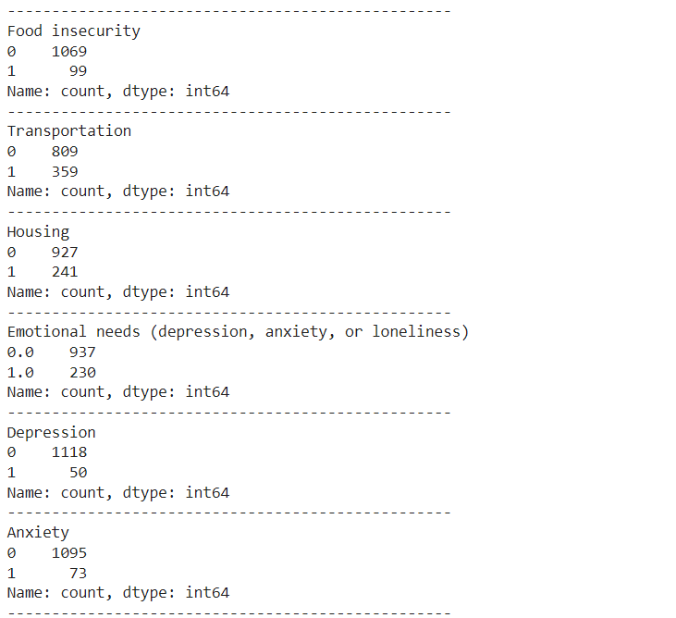
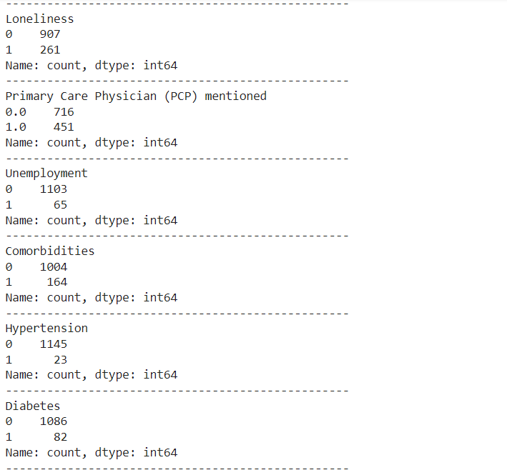
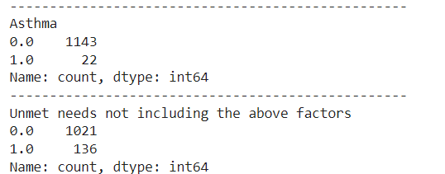
Generative model to find the presence of topic
0 – represents absence of topic, 1- represents presence of topic

Slide 17
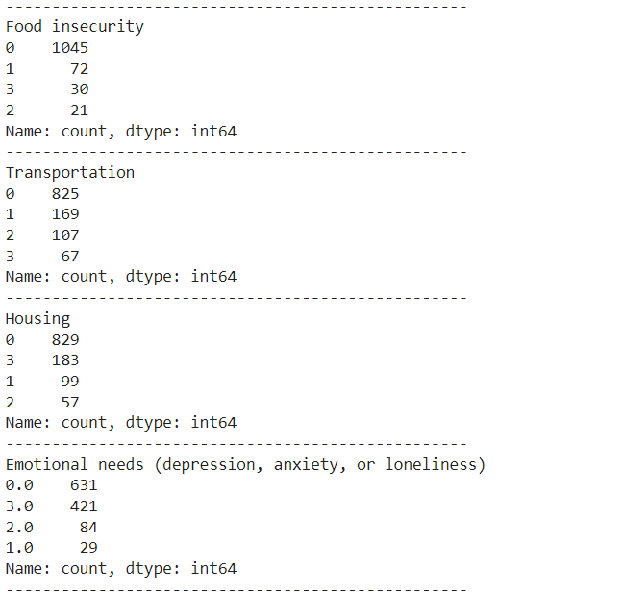
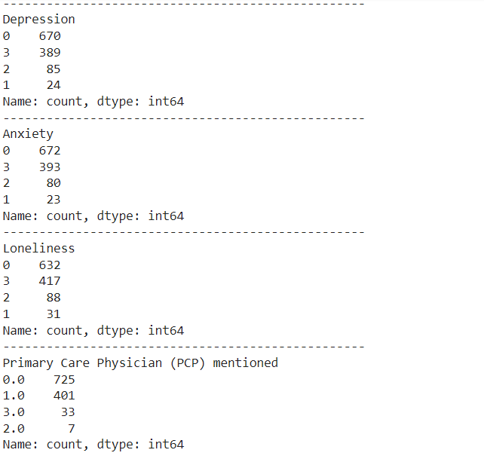
Generative model to find the presence & sentiment
Generative model to find whether the topic is discussed in the notes or not if discussed what is the sentiment of the topic.
0 – represents absence of topic, 1- represents positive, 2 – represents negative and 3 – represents neutral.

Slide 18
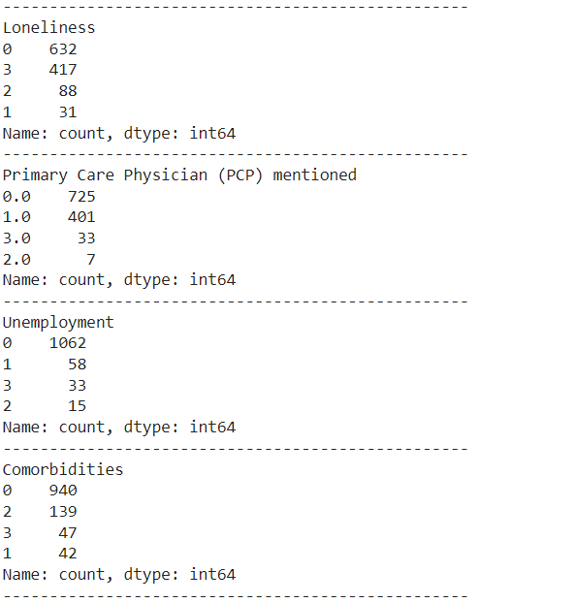
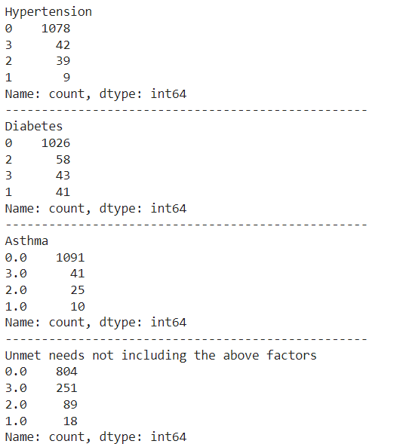
Generative model to find the presence & sentiment
Generative model to find whether the topic is discussed in the notes or not if discussed what is the sentiment of the topic.
0 – represents absence of topic, 1- represents positive, 2 – represents negative and 3 – represents neutral.

Slide 19
Generative model – Key Takeaways
Generated labels didn’t align with existing SDOH feature labels and target class.
Models showed bias in certain topics like loneliness, depression and anxiety (particularly for contacts with mentions like Declined, Left Voice Mail).

Slide 20
Topic Modeling
Topic exploration
Algorithms:
LDA (Latent Dirichlet Allocation)
Bitermplus

Slide 21
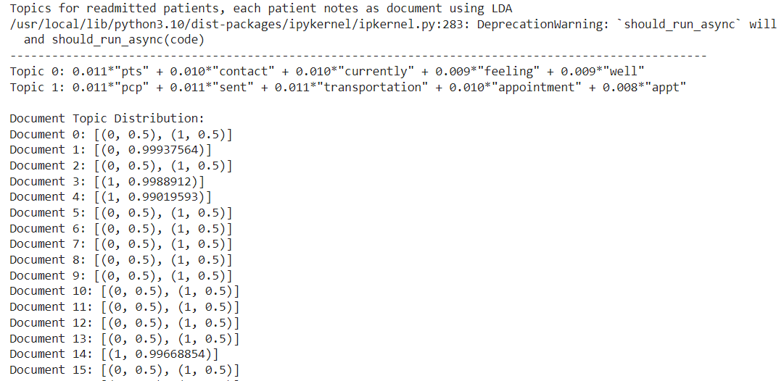
Readmitted pts individual notes - LDA
Notes from readmitted patients are considered.
Notes of each patient is considered as a document.
List of notes of all readmitted patients is given as a list of docs for LDA model

Slide 22
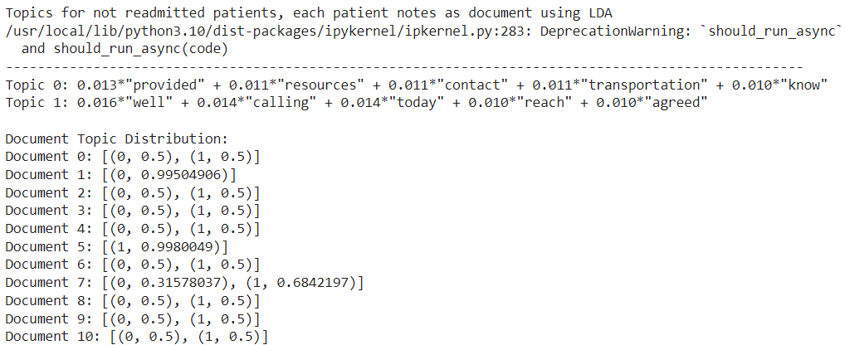
Not Readmitted pts individual notes - LDA
Notes from not readmitted patients are considered.
Notes of each patient is considered as a document.
List of notes of all not readmitted patients is given as a list of docs for LDA model

Slide 23
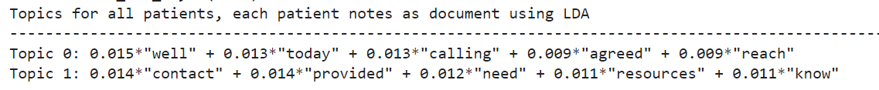
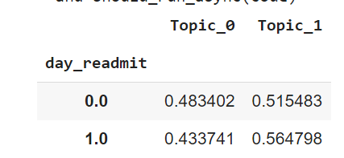
Topic modeling on all the patients with notes - LDA
Topic modeling is performed on all the patients with notes that has at least 1 character.
Following are the topics generated along with mean of topic distributions in readmitted and not readmitted patients.

Slide 24
Biterm Topic Model
Good at handling short texts
Analyze word pair co-occurrences
Limitation of LDA
Create sparse doc-term matrix on short texts

Slide 25
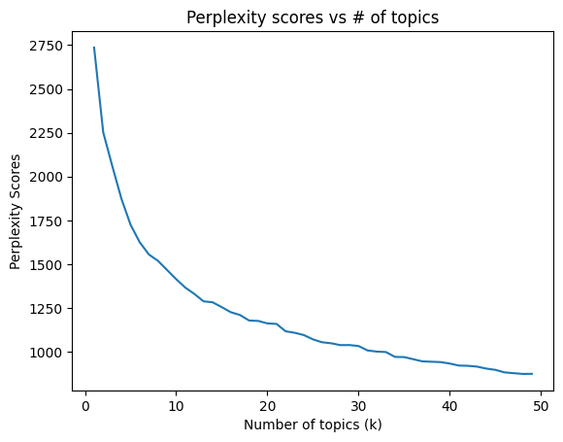
Bitermplus – optimal # of topics
Optimal # of topics considered to between 10 to 15 from the following Elbow plot.

Slide 26
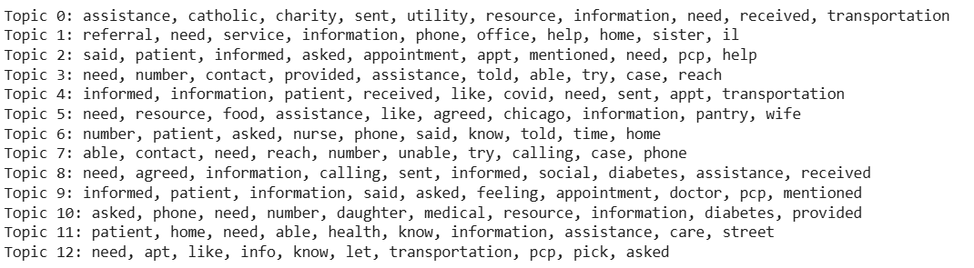
Bitermplus – Topics
Topics generated by Bitermplus

Slide 27
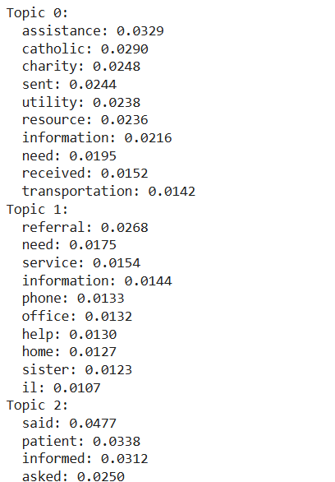
Bitermplus – Word probabilities
Word probabilities for all the topics

Slide 28
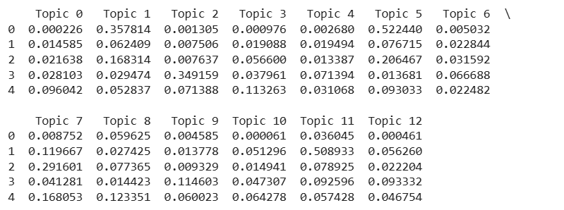
Bitermplus – Topic Probabilities
Topic distributions of top 5 documents.
Each record represent a document probability being assigned to the 12 chosen topics

Slide 29
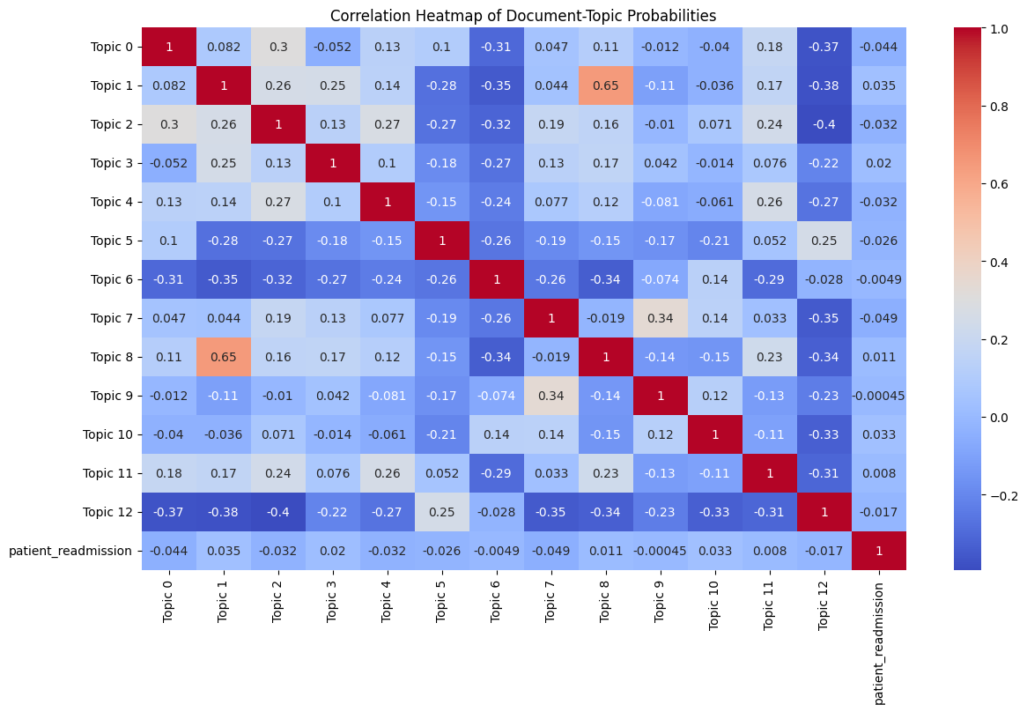
Bitermplus – Topic Probabilities correlation matrix
Correlation between topic probabilities for each of the topic and patient readmission.
No correlation was found in the topic probabilities of documents w.r.t Patient readmission

Slide 30
Topic Modeling – Key Takeaways
Generated topics are not correlated with target label
Low word probabilities defining weak topics
Future Direction:
Probabilities as feature vectors for readmission classification

Slide 31
Traditional Vectorization Techniques
Bag of Words
Term Frequency Inverse Document Frequency (TF-IDF)

Slide 32
TF-IDF Approach
Convert patient notes into vectors using TF-IDF
Filter the words with frequency thresholding (Min: 20 occurrences, Max: 70% of docs)
Resultant matrix had 400+ features only from notes which initially had 5400+ features

Slide 33
Random Forest - Feature Selection
Features extracted from TF-IDF are concatenated with Demographic and other tabular features
Random Forest classifier is trained on concatenated data
Selected top 25% features (100+) from both types of data (Demographic, other tabular & TF-IDF features)

Slide 34
Analysis Combinations
Records
All Patients – All the records
Patients with notes – Records of the patients with notes
Features
Demo – Demographics Features
Demo + Tabular – Demographic and other tabular features (SDOH)
Demo + Tabular – Demographic, other tabular features (SDOH) and Notes (TF-IDF vectors)
All Patients | Demo | Demo + Tabular | Demo + Tabular + Notes
Patients with notes | Demo | Demo + Tabular | Demo + Tabular + Notes

Slide 35
Analysis Combinations – Performance
Before FS – Model performances without feature selection
RF Feature Selection – Random Forest Feature Selector Model performance
After FS - Model performances with feature selection
# | Patients - Subsets | Features - Subsets | Model | Before FS CV AUC | RF Feature selection AUC | After FS CV AUC | Test AUC
1 | All patients | Demo | RandomForestClassifier | 0.5677 (± 0.0200) | 0.5677 (± 0.0200) | 0.5864 (± 0.0100) | 0.614
2 | All patients | Demo | AdaBoostClassifier | 0.6382 (± 0.0140) |  | 0.6169 (± 0.0076) | 0.647
3 | All patients | Demo | XGBClassifier | 0.5919 (± 0.0059) |  | 0.5941 (± 0.0076) | 0.615
4 | Patients with Notes | Demo | RandomForestClassifier | 0.5535 (± 0.0399) | 0.5535 (± 0.0399) | 0.5303 (± 0.0296) | 0.533
5 | Patients with Notes | Demo | AdaBoostClassifier | 0.5984 (± 0.0496) |  | 0.5696 (± 0.0402) | 0.610
6 | Patients with Notes | Demo | XGBClassifier | 0.5682 (± 0.0408) |  | 0.5518 (± 0.0297) | 0.561
7 | All patients | Demo + Tabular | RandomForestClassifier | 0.5880 (± 0.0209) | 0.5880 (± 0.0209) | 0.5886 (± 0.0143) | 0.647
8 | All patients | Demo + Tabular | AdaBoostClassifier | 0.6645 (± 0.0218) |  | 0.6576 (± 0.0189) | 0.706
9 | All patients | Demo + Tabular | XGBClassifier | 0.6207 (± 0.0278) |  | 0.6073 (± 0.0184) | 0.660
10 | Patients with Notes | Demo + Tabular | RandomForestClassifier | 0.5584 (± 0.0278) | 0.5584 (± 0.0278) | 0.5359 (± 0.0535) | 0.624
11 | Patients with Notes | Demo + Tabular | AdaBoostClassifier | 0.5933 (± 0.0383) |  | 0.6085 (± 0.0496) | 0.668
12 | Patients with Notes | Demo + Tabular | XGBClassifier | 0.5857 (± 0.0459) |  | 0.5615 (± 0.0387) | 0.581
13 | All patients | Demo + Tabular + Notes | RandomForestClassifier | 0.6586 (± 0.0144) | 0.6586 (± 0.0144) | 0.6777 (± 0.0170) | 0.682
14 | All patients | Demo + Tabular + Notes | AdaBoostClassifier | 0.6853 (± 0.0224) |  | 0.6883 (± 0.0226) | 0.710
15 | All patients | Demo + Tabular + Notes | XGBClassifier | 0.6788 (± 0.0232) |  | 0.6814 (± 0.0237) | 0.704
16 | Patients with Notes | Demo + Tabular + Notes | RandomForestClassifier | 0.6271 (± 0.0416) | 0.6271 (± 0.0416) | 0.7112 (± 0.0491) | 0.742
17 | Patients with Notes | Demo + Tabular + Notes | AdaBoostClassifier | 0.6143 (± 0.0317) |  | 0.6276 (± 0.0347) | 0.749
18 | Patients with Notes | Demo + Tabular + Notes | XGBClassifier | 0.6238 (± 0.0194) |  | 0.6491 (± 0.0218) | 0.708

Slide 36
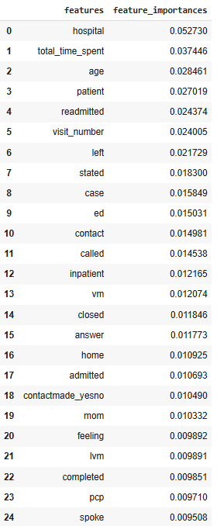
Feature Importances – Random Forest (Before FS)

Slide 37
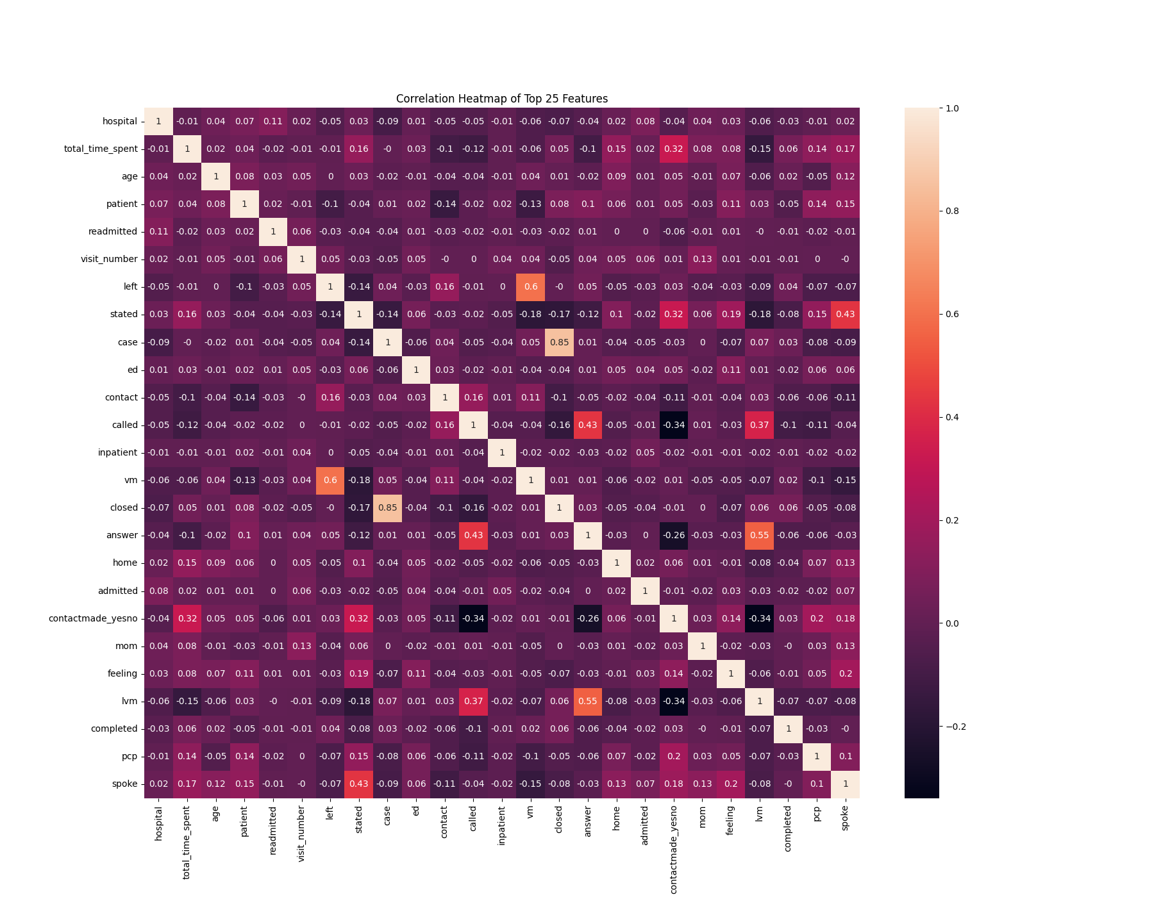
Top 25 important feature correlation

Slide 38
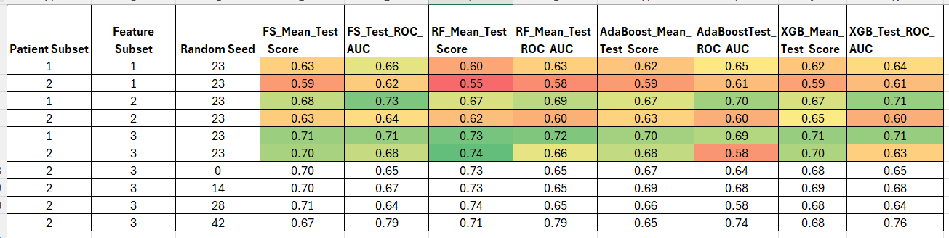
Analysis Combinations – Grid Search Performance
Patient Subset
1 – All the records
2 – Records of the patients with notes
Feature Subset
1 – Demographics Features
2 – Demographic and other tabular features (SDOH)
3 – Demographic, other tabular features (SDOH) and Notes (TF-IDF vectors)

Slide 39
Analysis Combinations – Grid Search Performance
Patient Subset
1 – All the records
2 – Records of the patients with notes
Feature Subset
1 – Demographics Features
2 – Demographic and other tabular features (SDOH)
3 – Demographic, other tabular features (SDOH) and Notes (TF-IDF vectors)

Slide 40
Traditional NLP Vectorization Techniques – Key Takeaways
Advantages
Can handle patients without notes by filling missing values with ‘0’s
Easy to limit the number of features to be extracted
Limitations
Contextual understanding will be lost

Slide 41
Future Directions
Summarize Notes using Generative LLMs and Vectorize with Embedding models
Improve Contact notes by leveraging resource notes

Slide 42
Patient without notes - Evaluation
Evaluated patients without notes using two different models:
Model trained on patients with notes
Model trained on all patients

Slide 43
Performance Metrics
Rows
Patient Subset: 1 – All patients; 2 – Patients with notes; 3 – Patients without notes
Feature Subset: 1 – Demographic; 2 – Demographic + Other Tabular; 3 - Demographic + Other Tabular + Notes
Columns
Models: FS - Feature Selection (Random Forest), RF – Random Forest, XGB - XGBoost
Evaluation: CV – 5 cross fold mean score (ROC-AUC); Test – Held out test set score
Patient Subset | Feature Subset | FS_CV_Test | FS_Test | RF_CV_Test | RF_Test | AdaBoost_CV_Test | AdaBoost_Test | XGB_CV_Test | XGB_Test
1 | 1 | 0.6324 | 0.6634 | 0.5964 | 0.6256 | 0.6194 | 0.6575 | 0.6151 | 0.6357
1 | 2 | 0.6782 | 0.7261 | 0.666 | 0.685 | 0.6648 | 0.7045 | 0.6633 | 0.7099
1 | 3 | 0.7083 | 0.7087 | 0.7271 | 0.7189 | 0.7067 | 0.6901 | 0.7093 | 0.7172
2 | 1 | 0.6042 | 0.6272 | 0.5599 | 0.5851 | 0.5885 | 0.6136 | 0.6014 | 0.6127
2 | 2 | 0.6206 | 0.6414 | 0.6259 | 0.5913 | 0.6098 | 0.6062 | 0.6328 | 0.6029
2 | 3 | 0.6779 | 0.6862 | 0.7214 | 0.6844 | 0.6722 | 0.5815 | 0.6893 | 0.6282
3 | 1 | 0.5963 | 0.6481 | 0.5675 | 0.5754 | 0.6078 | 0.6336 | 0.5953 | 0.6355
3 | 2 | 0.6298 | 0.6891 | 0.6074 | 0.6561 | 0.6157 | 0.6745 | 0.6124 | 0.6777
3 | 3 |  | 0.7037 |  | 0.6778 |  | 0.6105 |  | 0.6735
3 | 3 |  | 0.5692 |  | 0.5551 |  | 0.5538 |  | 0.5767

Slide 44
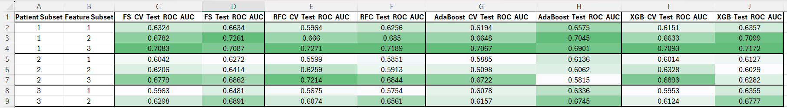
Performance Metrics – Grid Search

Slide 45
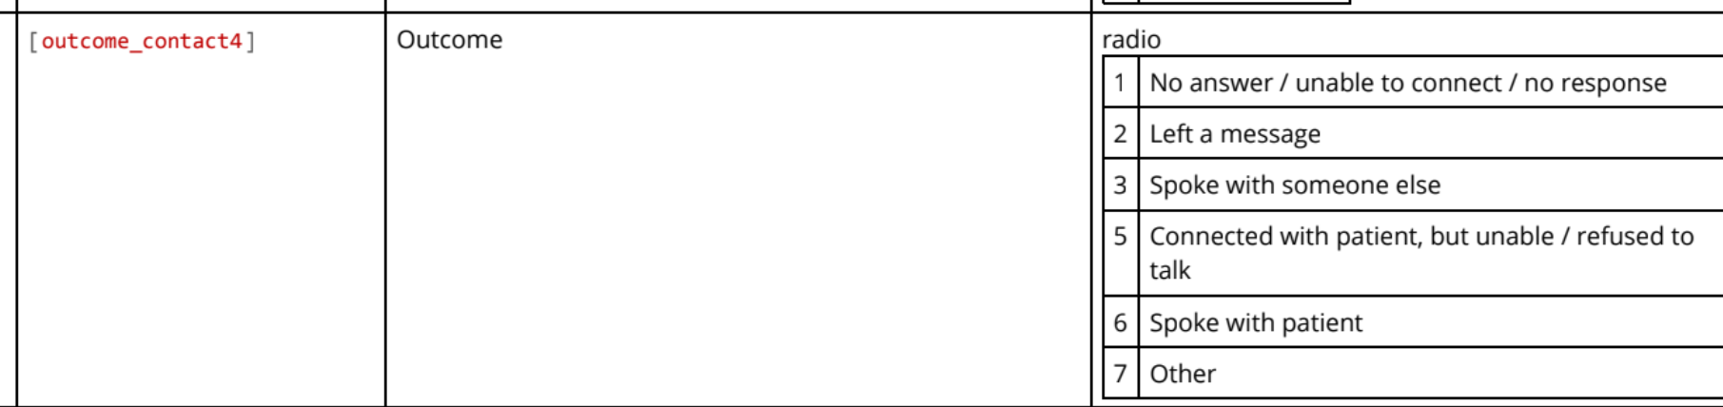
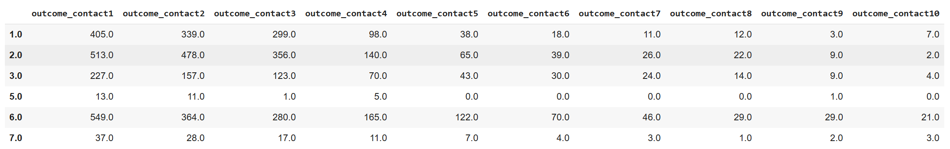
Outcome Contact – Value Counts
Outcome contact represents what is the outcome of the contact attempt

Slide 46
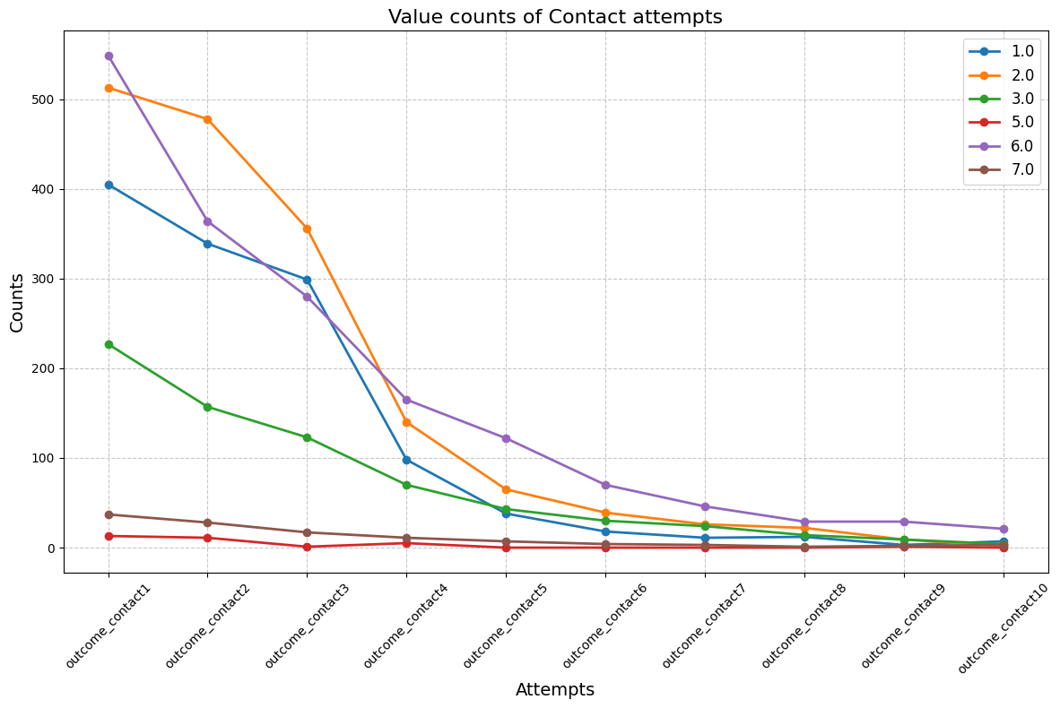
Outcome Contact – Value Counts

Slide 47
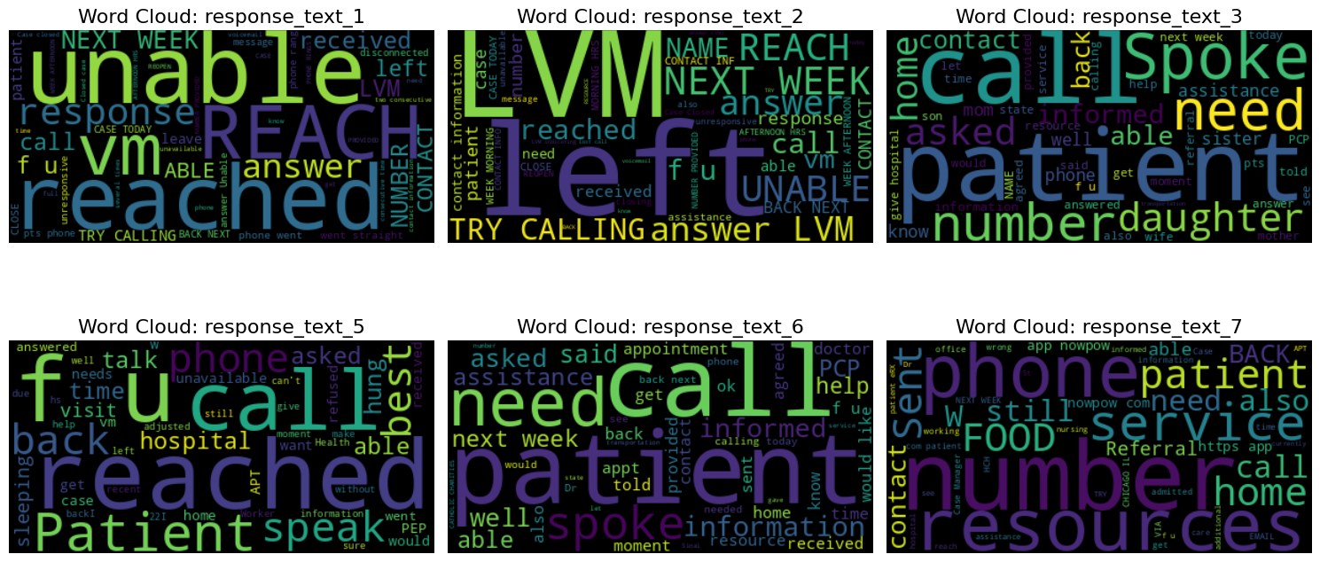
Outcome Contact – Word Clouds

Slide 48
Performance Metrics – Including Outcome Contact
Before including outcome contact
Patient Subset | Feature Subset | FS_CV_Test | FS_Test | RF_CV_Test | RF_Test | AdaBoost_CV_Test | AdaBoost_Test | XGB_CV_Test | XGB_Test
1 | 1 | 0.6324 | 0.6634 | 0.5964 | 0.6256 | 0.6194 | 0.6575 | 0.6151 | 0.6357
1 | 2 | 0.6782 | 0.7261 | 0.666 | 0.685 | 0.6648 | 0.7045 | 0.6633 | 0.7099
1 | 3 | 0.7083 | 0.7087 | 0.7271 | 0.7189 | 0.7067 | 0.6901 | 0.7093 | 0.7172
2 | 1 | 0.6042 | 0.6272 | 0.5599 | 0.5851 | 0.5885 | 0.6136 | 0.6014 | 0.6127
2 | 2 | 0.6206 | 0.6414 | 0.6259 | 0.5913 | 0.6098 | 0.6062 | 0.6328 | 0.6029
2 | 3 | 0.6779 | 0.6862 | 0.7214 | 0.6844 | 0.6722 | 0.5815 | 0.6893 | 0.6282
3 | 1 | 0.5963 | 0.6481 | 0.5675 | 0.5754 | 0.6078 | 0.6336 | 0.5953 | 0.6355
3 | 2 | 0.6298 | 0.6891 | 0.6074 | 0.6561 | 0.6157 | 0.6745 | 0.6124 | 0.6777
After including outcome contact
Patient Subset | Feature Subset | FS_CV_Test | FS_Test | RF_CV_Test | RF_Test | AdaBoost_CV_Test | AdaBoost_Test | XGB_CV_Test | XGB_Test
1 | 1 | 0.6852 | 0.7113 | 0.5911 | 0.5832 | 0.6484 | 0.6698 | 0.6451 | 0.6491
1 | 2 | 0.7002 | 0.7397 | 0.6878 | 0.7195 | 0.6839 | 0.7358 | 0.6959 | 0.7284
1 | 3 | 0.7166 | 0.7323 | 0.7363 | 0.7305 | 0.7228 | 0.7299 | 0.7228 | 0.7383
2 | 1 | 0.6467 | 0.6122 | 0.5186 | 0.4776 | 0.5574 | 0.57 | 0.5357 | 0.5367
2 | 2 | 0.6693 | 0.6183 | 0.6695 | 0.6379 | 0.6342 | 0.6274 | 0.6732 | 0.6479
2 | 3 | 0.6958 | 0.6359 | 0.7238 | 0.6682 | 0.6741 | 0.5778 | 0.6898 | 0.6215
3 | 1 | 0.6267 | 0.5842 | 0.5698 | 0.4938 | 0.6039 | 0.5532 | 0.5965 | 0.5282
3 | 2 | 0.6574 | 0.6097 | 0.626 | 0.6197 | 0.6534 | 0.6386 | 0.6502 | 0.577

Slide 49
Next Steps
Train multiple models with different outcome contact labels
Perform Topic Modelling after cleaning notes based on labels

Slide 50
Recap
Cross model evaluation on patients without notes
Story on the findings

Slide 51
Performance Metrics – Engaged vs Not Engaged
Engaged is included in the analysis
Random Seed is 23 in the entire analysis
Patient Subset | Feature Subset | Engaged | FS_CV_Test | FS_Test | RF_CV_Test | RF_Test | AdaBoost_CV_Test | AdaBoostTest | XGB_CV_Test | XGB_Test
1 | 1 | 0 | 0.59 | 0.65 | 0.57 | 0.60 | 0.59 | 0.65 | 0.59 | 0.63
1 | 1 | 1 | 0.63 | 0.69 | 0.61 | 0.50 | 0.64 | 0.66 | 0.63 | 0.65
1 | 2 | 0 | 0.65 | 0.68 | 0.63 | 0.68 | 0.63 | 0.72 | 0.64 | 0.69
1 | 2 | 1 | 0.67 | 0.75 | 0.68 | 0.74 | 0.64 | 0.74 | 0.64 | 0.76
1 | 3 | 0 | 0.66 | 0.68 | 0.67 | 0.69 | 0.64 | 0.72 | 0.65 | 0.70
1 | 3 | 1 | 0.73 | 0.74 | 0.76 | 0.75 | 0.67 | 0.70 | 0.71 | 0.75
2 | 1 | 0 | 0.62 | 0.64 | 0.56 | 0.55 | 0.57 | 0.64 | 0.58 | 0.60
2 | 1 | 1 | 0.69 | 0.63 | 0.61 | 0.54 | 0.68 | 0.55 | 0.64 | 0.63
2 | 2 | 0 | 0.63 | 0.61 | 0.61 | 0.61 | 0.63 | 0.64 | 0.64 | 0.63
2 | 2 | 1 | 0.74 | 0.64 | 0.76 | 0.61 | 0.73 | 0.57 | 0.73 | 0.59
2 | 3 | 0 | 0.64 | 0.64 | 0.67 | 0.59 | 0.64 | 0.65 | 0.64 | 0.66
2 | 3 | 1 | 0.72 | 0.70 | 0.76 | 0.64 | 0.72 | 0.44 | 0.72 | 0.71
3 | 1 | 0 | 0.60 | 0.57 | 0.54 | 0.53 | 0.59 | 0.61 | 0.58 | 0.60
3 | 1 | 1 | 0.52 | 0.13 | 0.46 | 0.19 | 0.52 | 0.38 | 0.59 | 0.56
3 | 2 | 0 | 0.65 | 0.57 | 0.63 | 0.56 | 0.64 | 0.58 | 0.63 | 0.60
3 | 2 | 1 | 0.68 | 0.81 | 0.70 | 0.88 | 0.73 | 0.75 | 0.53 | 1.00

Slide 52
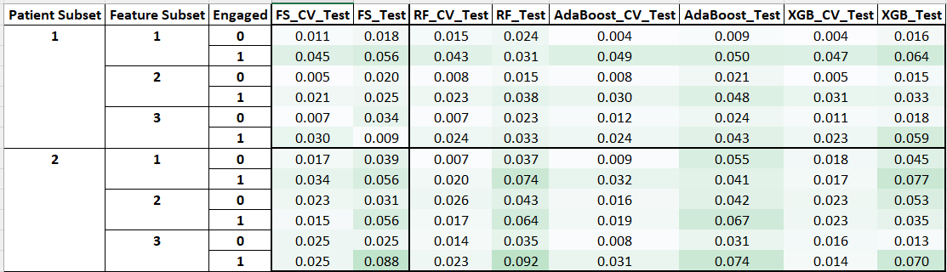
Performance Metrics – Engaged vs Not Engaged (Std)
Engaged is included in the analysis
Metrics aggregation on 5 Random Seeds in the range (0,50,10)

Slide 53
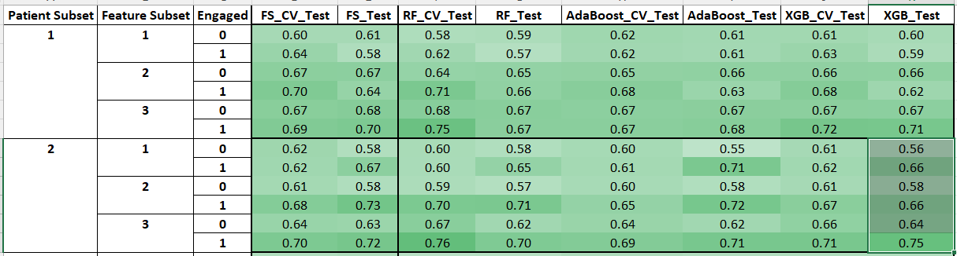
Performance Metrics – Engaged vs Not Engaged (Mean)
Engaged is included in the analysis
Metrics aggregation on 5 Random Seeds in the range (0,50,10)

Slide 54
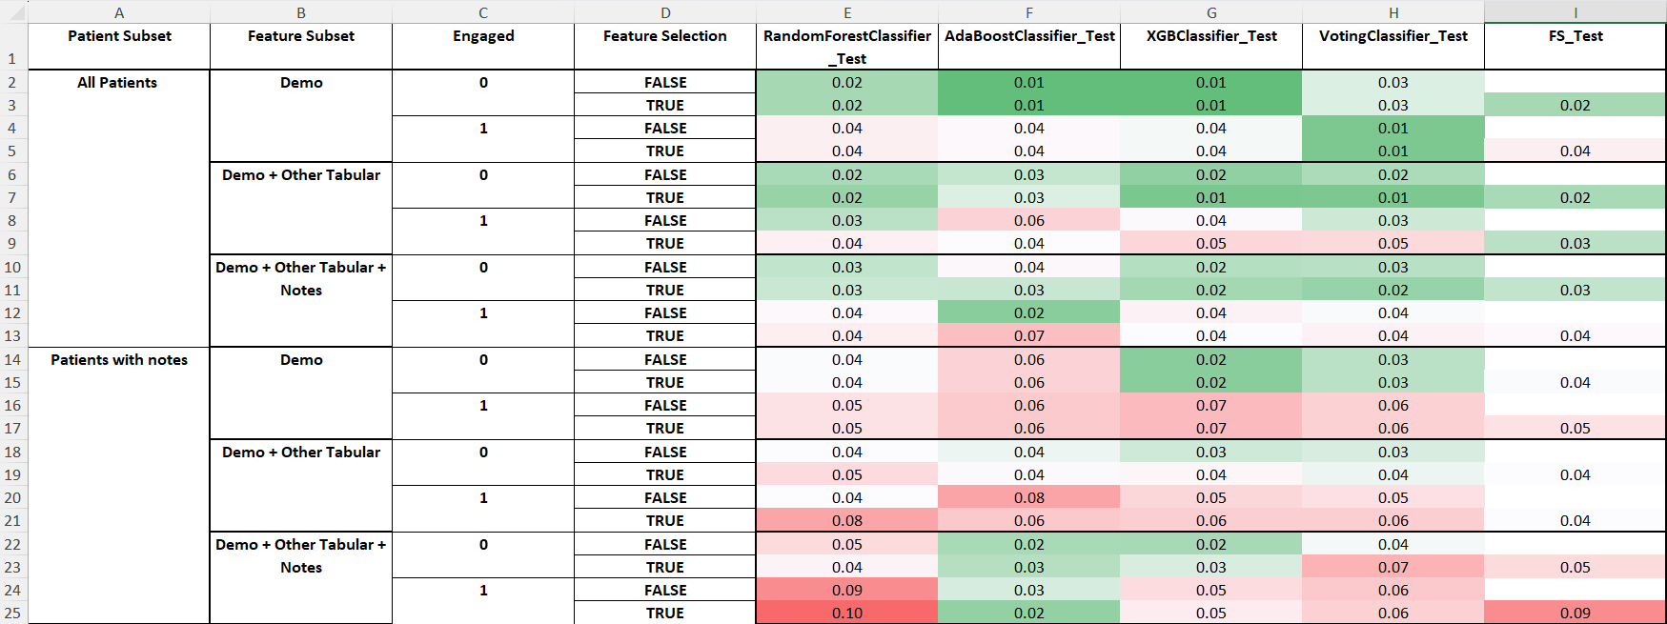
Performance Metrics – Feature Selection (Std)
Engaged, Feature Selection is included in the analysis
Metrics aggregation on 5 Random Seeds in the range (0,50,10)

Slide 55
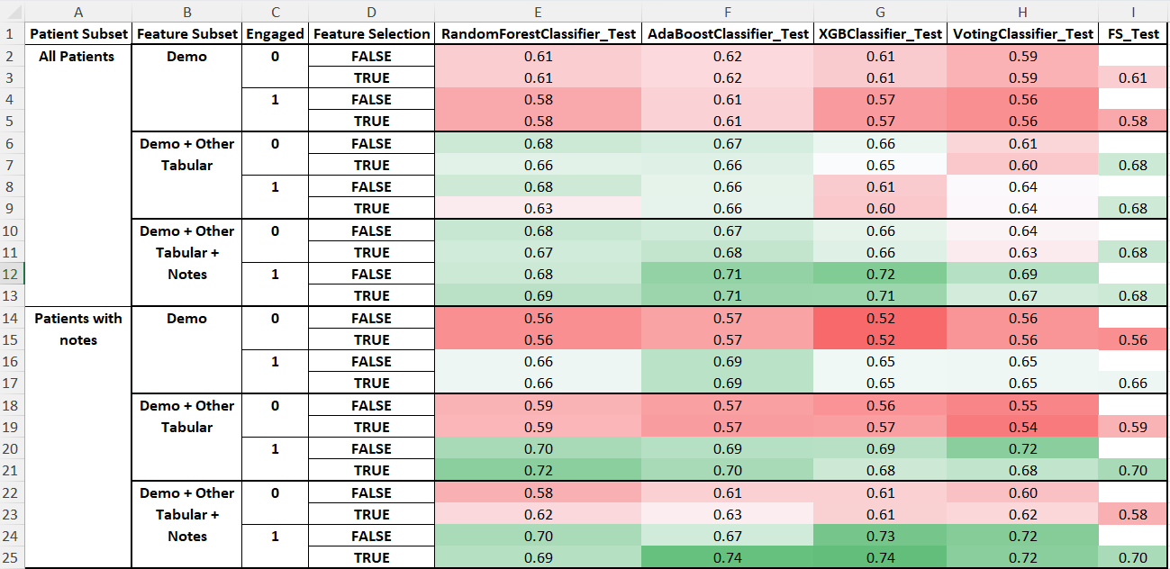
Performance Metrics – Feature Selection (Mean)
Engaged, Feature Selection is included in the analysis
Metrics aggregation on 5 Random Seeds in the range (0,50,10)

Slide 56
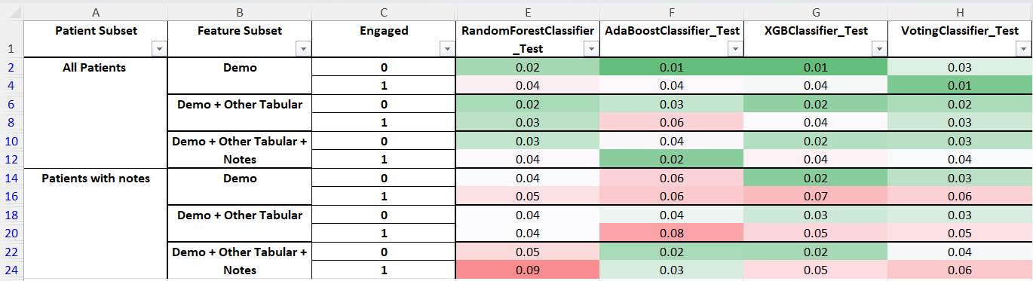
Performance Metrics (Std - without Feature Selection)
Engaged, Feature Selection is included in the analysis
Metrics aggregation on 5 Random Seeds in the range (0,50,10)

Slide 57
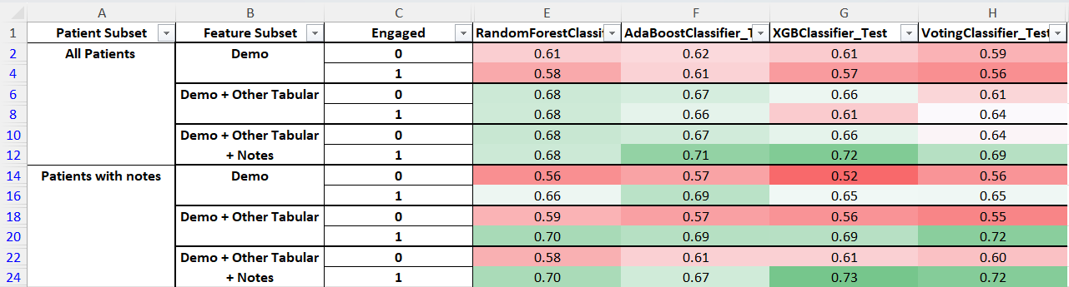
Performance Metrics (Mean - without Feature Selection)
Engaged, Feature Selection is included in the analysis
Metrics aggregation on 5 Random Seeds in the range (0,50,10)

Slide 58
Findings – Feature subset/ Patient subset & Engaged
Mean and Standard Deviation of all the models experimented
Every single type of patients are improving by adding notes at least by 1% and at most by 5%
Model performance is significantly higher (min: 11% and max: 13% ) for Patients with notes when they are engaged.
Patient Subset | All Patients |  | Patients with Notes
Feature Subset/ Engaged | Not engaged | Engaged | Not engaged | Engaged
Demo | 0.60 (0.01) | 0.58 (0.02) | 0.55 (0.02) | 0.66 (0.01)
Demo + Other Tabular | 0.65 (0.02) | 0.65 (0.03) | 0.57 (0.01) | 0.70 (0.01)
Demo + Other Tabular + Notes | 0.66 (0.02) | 0.70 (0.02) | 0.60 (0.01) | 0.71 (0.02)

Slide 59
Findings – Feature subset/ Patient subset & Engaged
Performance of best model – XGBoost
Every single type of patients are improving by adding notes atmost by 11% (except for All not engaged patients)
Model performance is significantly higher (12 - 13% ) for Patients with notes when they are engaged.
Patient Subset | All Patients |  | Patients with Notes
Feature Subset/ Engaged | Not engaged | Engaged | Not engaged | Engaged
Demo | 0.61 | 0.57 | 0.52 | 0.65
Demo + Other Tabular | 0.66 | 0.61 | 0.56 | 0.69
Demo + Other Tabular + Notes | 0.66 | 0.72 | 0.61 | 0.73

Slide 60
Last Week Recap
ROC-AUC metric summarization
Feature Selection – Not improving the ROC-AUC metric
Best performance - XGBoost
Include # of samples in each of the combinations
Include Sensitivity in the performance metrics (Poor performance)
Research Symposium Poster
Replace TF-IDF with BERT embeddings

Slide 61
Findings – Feature subset/ Patient subset & Engaged
In all patients data, not engaged patients are dominating the engaged patients with double the number
In patients with notes data, engaged and not engaged are almost equally distributed
Patient Subset | All Patients (2613 ) |  | Patients with Notes (1536)
Feature Subset/ Engaged | Not engaged (1743) | Engaged (870) | Not engaged (751) | Engaged (785)
Demo (12) | 0.61 | 0.57 | 0.52 | 0.65
Demo + Other Tabular ((71) | 0.66 | 0.61 | 0.56 | 0.69
Demo + Other Tabular + Notes (431) | 0.66 | 0.72 | 0.61 | 0.73
Demo – Demographic features, Other Tabular – SDOH features & CHW Logs, Notes – Patient Contact notes
Values in the cells represent XGBoost model performance w.r.t the Patient and Feature Subset type
Numbers in the parathesis are # of samples/ features

Slide 62
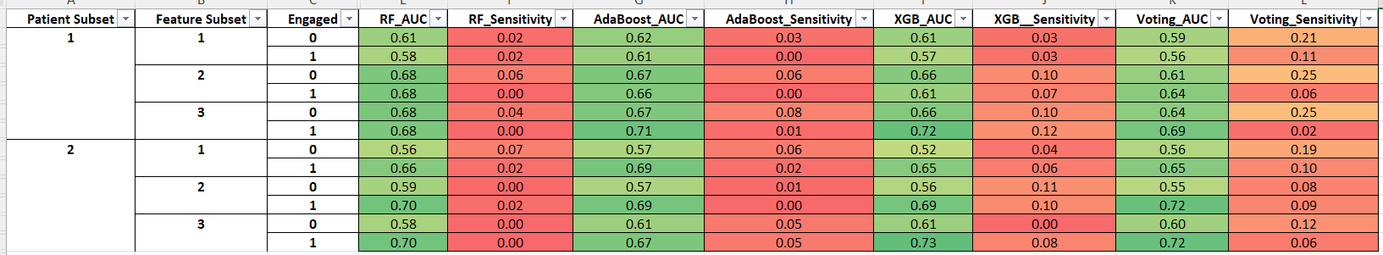
Sensitivity scores
Models are having less than 10% sensitivity in most of the combinations for a threshold of 0.5

Slide 63
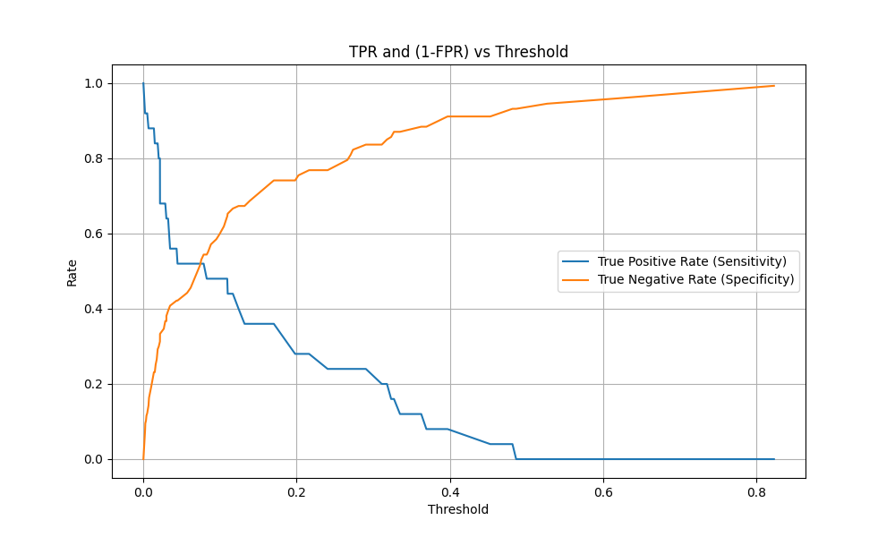
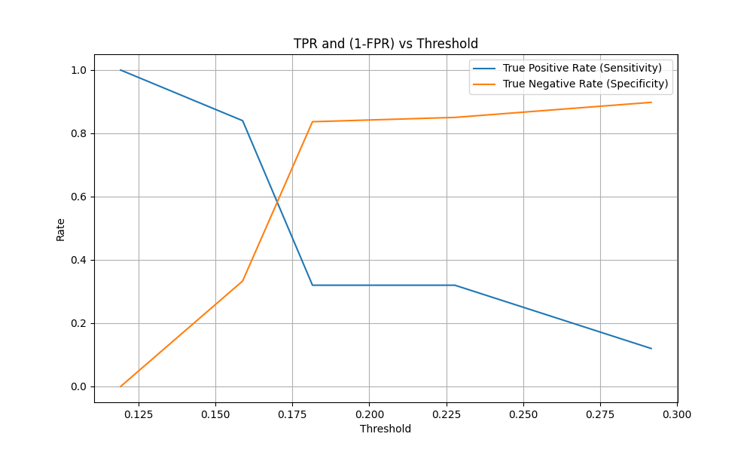
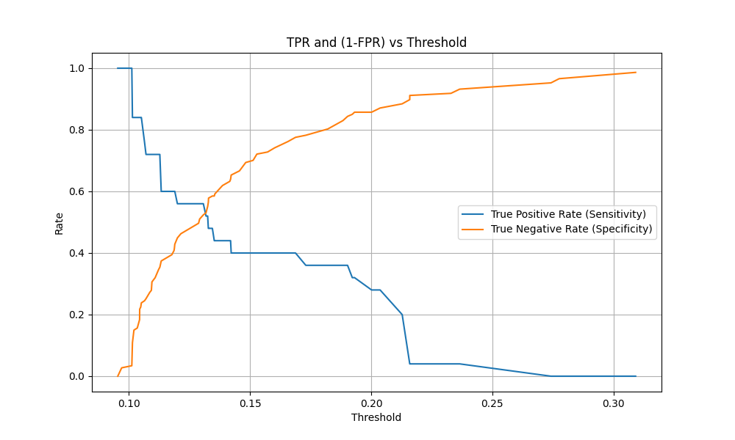
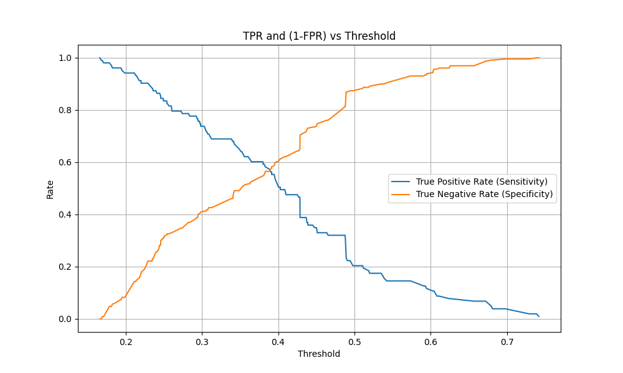
Sensitivity scores
Goal: Identify optimal threshold to trade-off between Sensitivity and Specificity
Random Forest
AdaBoost
XGBoost
Voting
Above graphs are related to All patients with only demographic features considered

Slide 64
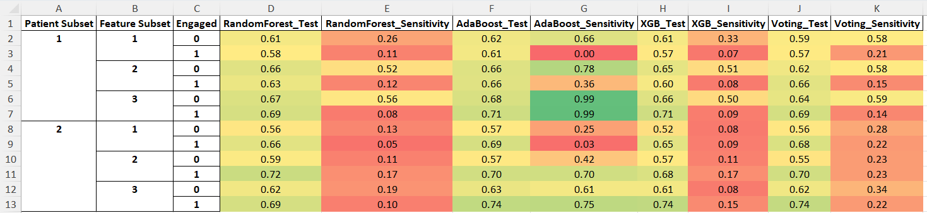
Sensitivity scores
Models are having better sensitivity in most of the combinations for a threshold of 0.35

Slide 65
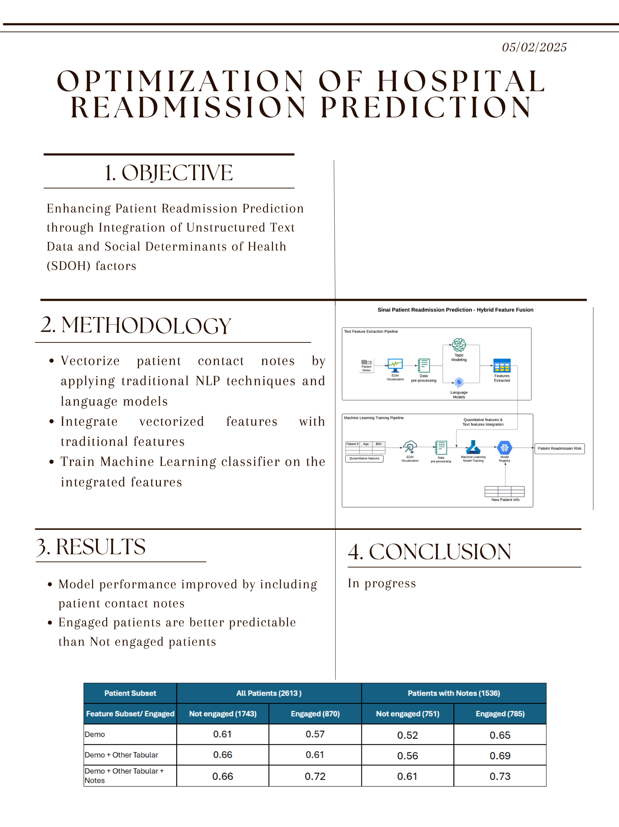
Research Symposium Poster
Data description and Conclusion are in progress

Slide 66
Next Steps
Identify the best thresholds for each combination to evaluate Sensitivity
BERT Classification

Slide 67
Previous Week Recap (05/05/25)
Sensitivity score analysis
Selecting optimal threshold to improve Sensitivity scores
Recommendations at Research Symposium

Slide 68

BERT Analysis
Question: Does embedding models perform better than traditional NLP techniques (TF-IDF)?
BERT embeddings didn’t perform better than TF-IDF
BERT with PCA performed comparatively better than without PCA except for XGBoost model with engaged patients

Slide 69
Research Symposium Feedback
Include additional features
Genealogy data (Family illness history)
Address (Locality)
Low dimensional embeddings
Project embeddings onto a lower dimensional space
Lower-dimensional embedding models (MiniLM)

Slide 70
Next Week
Cost Sensitive Learning (In progress)
Compare BERT with Clinical BERT, Sentence Transformers (In progress)
Re-run the entire script with Extracted/ Summarized text
Outline the paper for E-Science publication

Slide 71

Previous Week Recap (05/12/25)
BERT embeddings performance analysis
Paper draft for E-Science publication

Slide 72

Summarized Notes Analysis
Question: Does classifiers perform better after extracting summaries with TF-IDF vectors?

Slide 73

Summarized Notes Analysis
Question: Does classifiers perform better after extracting summaries with embedding models?

Slide 74
Next Week
Complete all parts of the paper
Explore other embeddings models

Slide 75
Previous Week Recap (05/19/25)
Paper review & feedback
Inclusion of other sections (Literature Review, Discussion and Conclusion)
Update Methodology Diagram
Included 2 tables for performance metrics of different patient subsets

Slide 76

Methodology Diagram
Updated based on the last week feedback

Slide 77
Tables in the results sections
Two tables for all the combinations
First table: All the patients
Rows: Feature subsets – 4 combinations (Demo → Demo + Tabular + TF-IDF on Summarized Notes)
Columns: Engaged/ Not-Engaged
Cell values: XGBoost model ROC-AUC score
Second table: Patients with notes
Rows: Feature subsets – 6 combinations (Demo → Demo + Tabular + BERT on Summarized Notes)
Columns: Engaged/ Not-Engaged
Cell values: XGBoost model ROC-AUC score

Slide 78
Next Week
Final review of the paper
Including additional visuals/ tables if needed

Slide 79
E-Science Paper – Title & Authors
Leveraging Hidden Patterns in Open-Ended Health Workers’ Notes to Improve Prediction of Patient Readmission
Authors
Naveen Kumar Reddy
Ankita Mishra
Navika Maglani
Sameer Shaik
Kelly McCabe
Jacob Furst
Daniela Stan Raicu
Roselyne Tchoua
Jamshid Sourati

Slide 80
Problem
How to effectively incorporate contact notes in the predictable model?

Slide 81
Goal & Hypothesis
Goal: Build an interpretable model that fuses demographics + SDOH + CHW notes and improve patient readmission predictability.
Hypothesis: adding unstructured notes will raise ROC-AUC vs. tabular-only baseline.

Slide 82
Methodology
Dataset & Pre-processing (missing-value fixes, concatenate ≤ 10 notes/pt).
Feature extraction: TF-IDF (terms threshold), BERT + PCA.
Machine Learning Models: RF, AdaBoost, XGBoost (grid-search, 5× CV).
Generative LLM Summarization

Slide 83


Results
Best: XGBoost + TF-IDF
Engaged pts: AUC 0.71 vs. 0.60 (tabular only) → +11
Summaries & BERT under-performed.

Slide 84
Discussion
TF-IDF beat contextual embeddings because CHW notes are short/telegraphic.

Slide 85
Next Steps / Future Work
Filter target-leaking terms (“readmitted”). Explore n-grams & domain-tuned LLM embeddings. Temporal validation.

Slide 86
Comparison
Comparison Aspect | Naveen | Ankita
Primary Goal | Improve interpretability while boosting AUC by incorporating contact notes. | NLP framework that classifies contact notes as food-related
Best Model | XGBoost + TF-IDF, +11 pp (engaged). | Doc2Vec + vocabulary list 3
Key Features | terms ( resource, medical, family, pcp, lvm ) dominate top-20 features.
Next-Step Priority | n-gram level analysis, Remove leakage tokens; temporal filtering. | imputation of missing data for 30-day readmission prediction; extend framework to include all SDoH features

Slide 87
Previous Week Recap (06/09/25)
PowerPoint Summary of E-Science conference paper
Basic formatting changes in the paper
30 trials on the entire analysis
Distribution analysis of top 20 important features

Slide 88
Results
30 trials analysis on all patients with 95% of Confidence Intervals
Random seeds from 0 - 29
Feature Subset | Not Engaged (n=1743) | Engaged (n=870)
Tabular | 0.68 ± 0.01 | 0.65 ± 0.02
Tabular + Notes (TF-IDF) | 0.68 ± 0.01 | 0.67 ± 0.02
Tabular + Summarized Notes (TF-IDF) | 0.67 ± 0.01 | 0.66 ± 0.02

Slide 89
Results
30 trials analysis on patients with notes (Random seeds from 0 – 29)
Feature Subset | Not Engaged (n=1743) | Engaged (n=870)
Tabular | 0.6 ± 0.02 | 0.66 ± 0.02
Tabular + Notes (TF-IDF) | 0.6 ± 0.01 | 0.66 ± 0.02
Tabular + Summarized Notes (TF-IDF) | 0.58 ± 0.02 | 0.65 ± 0.02
Tabular + Notes (BERT) | 0.58 ± 0.02 | 0.6 ± 0.02
Tabular + Summarized Notes (BERT) | 0.57 ± 0.02 | 0.62 ± 0.02

Slide 90
Distribution analysis of top 20 important features
Engaged patient's category from Patient with notes is considered for this analysis
Aggregated feature importances of the 5 runs with different random seeds
Analyzed distribution of 5 tabular and 15 TF-IDF features

Slide 91

Distribution analysis of top 20 important features

Slide 92


Distribution analysis of top 20 important features

Slide 93




Distribution analysis of top 20 important features

Slide 94




Distribution analysis of top 20 important features

Slide 95




Distribution analysis of top 20 important features

Slide 96




Distribution analysis of top 20 important features

Slide 97



Distribution analysis of top 20 important features

Slide 98
Next Week
Knowledge transfer to Ankita Tank

